Slide 1
Estimating the ROI of Switching to Magento Commerce
Worksheet

Slide 2

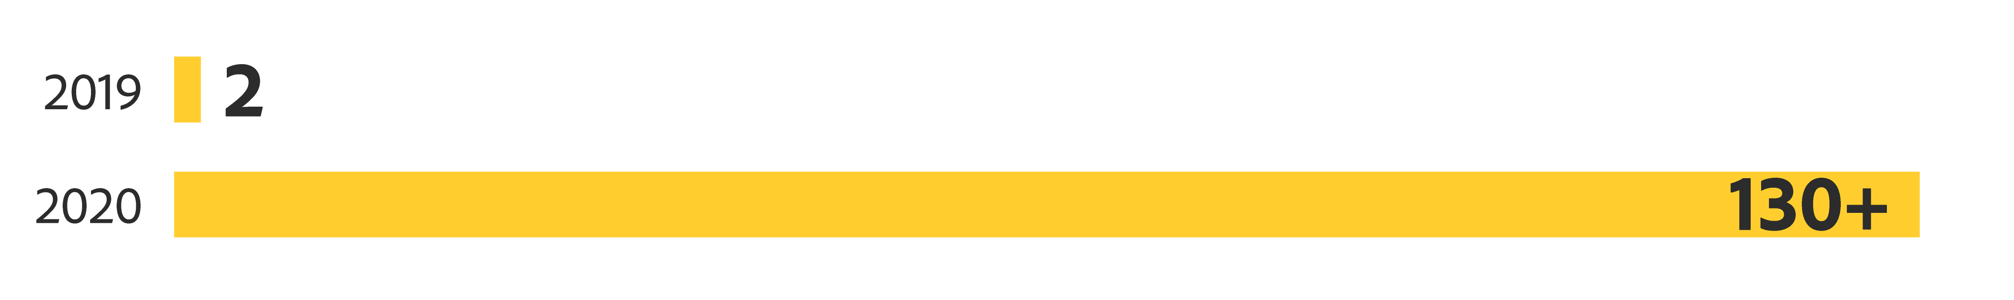
Today is an era of unprecedented eCommerce growth
Number of days in year whose digital retail sales reached $2 billion:
Note: Holidays were excluded from these counts.

Slide 3

But economic uncertainty remains
of CFOs surveyed felt that their companies
were affected either negatively or very negatively
by the crisis.

Slide 4

Businesses need a high-ROI eCommerce platform
No two businesses are alike, so every ROI estimate
will be different.
This worksheet will help you estimate the ROI of
switching to Magento Commerce for your business.

Slide 5

Four paths to eCommerce
1
2
3
4
New install
Replatform homegrown solution
Migrate from competing solution
Migrate from
Magento Open Source

Slide 6
Estimating the ROI of a new install
For the first three years:
Year 1
Projected eCommerce revenue – [Platform customization + installation + software licensing + support + hosting/infrastructure costs] = X
Year 2
[Projected eCommerce revenue + X] – [Maintenance + software licensing + support
+ hosting/infrastructure costs] = Y
Year 3
[Projected eCommerce revenue + Y] – [Maintenance + software licensing + support
+ hosting/infrastructure costs] = Z
Note: X and Y may be negative numbers.

Slide 7

How migration to Magento Commerce can increase revenue
Magento Commerce can help you boost the following:
Site traffic:
Conversion rates:
Average order value:
Mobile revenue:
25%
Average ROI of Magento migration:
16%
165% over 3 years
5%
Average payback period:
16%
8.1 months

Slide 8
Estimating your revenue lift from Magento Commerce
 | Year 1 | Year 2 | Year 3
Revenue | Fill in | Fill in | Fill in
Organic growth | Fill in | Fill in | Fill in
Magento Commerce attributable growth | 2.1% | 2.1% | 2.1%
Revenue lift | Revenue x 0.021 | Revenue x 0.021 | Revenue x 0.021
Note: On a revenue-weighted basis, Stax study participants attributed a 2.1% annual increase in
revenue growth above their organic growth.

Slide 9

How Magento Commerce can decrease your costs
Magento Commerce can help you reduce the following:
Downtime:
Content creation time:
Extension costs:
93%
61%
$12,000
Note: Costs may be reduced by as much as $12,000 per extension (including reduced licensing, customization, and maintenance needs).

Slide 10
Estimating cost reductions from Magento Commerce
 | Competing platform | Magento Commerce
B2C commerce platform | Add software license fees | Software licensing fees + managed cloud
B2B commerce platform | Add software license fees
CMS tools | Add software license fees
Product recommendations | Add software license fees | Revenue x 0.021
Business intelligence | Add software license fees
Hosting/infrastructure | Add hosting + CDN costs
Performance monitoring | Add New Relic or similar performance monitoring cost | Finance, manufacturing, technology
Service and support | Add support costs and/or IT allocation | 150 new names at target accounts
Systems integration | Add costs if platform must be integrated with CMS, back-end system (e.g., ERP), or pricing engine.
Design/test/implement | Add developer costs and/or IT allocations | Add Magento partner fees or IT hours
Extensions and customizations | Add software fees, developer fees, and/or IT hours | Add Magento partner fees, developer fees, or IT hours

Slide 11

Take the next step
Ready to learn more about the ROI your business
could achieve on Magento Commerce?
Take an interactive product tour.

Slide 12
Copyright © 2021 Adobe. All rights reserved.
Adobe, the Adobe logo, and Adobe Experience Cloud are either registered trademarks or trademarks of Adobe in the United States and/or other countries.

