Slide 1
Account-Based Marketing Demand Orchestration Template

Slide 2
Account-Based Marketing Essentials
The most complete ABM solution, accessible to all marketers regardless of company size or maturity.
Learn more at
marketo.com/solutions/account-based-marketing

Slide 3
STAGE | TOP OF FUNNEL | MIDDLE OF FUNNEL | BOTTOM OF FUNNEL | WON OPPORTUNITY | LOST OPPORTUNITY
STRATEGY | Introduce target accounts to brand and benefits of product | Prioritize and transition interested accounts from education to sales | Convince and convert prospects to customers | Create advocates; leverage that content with prospects | Lost is only temporary, keep on pulse for future sale
METRIC | Engagement | Pipeline | Revenue | Referrals | Recovery Rate
SECONDARY METRICS | Awareness and net new accounts / contacts Contact coverage | Opportunities | Velocity / sales cycle and win rate | Net Promoter Score (NPS) | N/A
SALES & SUCCESS | Account Development Rep (ADR) Follow on social from personal account Persona prospecting with outreach that is engagement score-based and personalized Account-based contact sequence Pre-event appointments to stop by tradeshow booth Re-prospect returning visitors |  | Account Executive (AE) Follow on social from AE account In person visits | Account Manager (AM) Follow on social from AM account Swag ‘welcome kit’ Tutorials & workshops In person visits | Account Executive (AE) Re-prospecting
DEMAND | Audience: Master Target Account List Event sponsorships + pre-event efforts (parties, sweepstakes) Field marketing: parties Paid search Paid social: gated/ungated educational content (net new contacts) Display Direct Mail: postcards, branded swag, gift box, physical books Industry alliances Connection prospecting for introductions (e.g. LinkedIn) ADR enablement | Audience: Engaged Accounts Event sponsorships (include element of targeted engagement - e.g. call out key contacts/accounts) Field marketing: educational sessions Paid search Display and retargeting (account based) Paid social: product content, case studies Direct Mail: postcards, branded swag, gift box, physical books ADR enablement | Audience: Open Opps Field marketing: educational workshop sessions, dinners, sales trips Paid search: competitive Paid social: convince content Display and retargeting Direct mail: convince content Exec-to-Exec campaign | Audience: Cross/Upsell Accounts All efforts in top, middle, and bottom of funnel columns | Remove from marketing target account list for specific time period
CONTENT | Email: nurture workflows based on account grade & content downloaded, weekly blasts to house list Blog posts, guest posts on key blogs Ebooks, whitepapers & data/research reports PR & analyst relations Partner marketing Customer presentations Terminology personalization by industry across all content (website, social, ads, DM, etc.) | Product overview video Topic-based webinars, case studies with customers Partner marketing (webinars, ebooks, etc.) One-pagers, sales enablement collateral Website personalization (industry, geo, role) Persona-specific web pages Account-specific content Terminology personalization by account, persona across all content (website, social, ads, DM, etc.) | Case studies & testimonials Video case studies Sales presentation Exec-to-Exec content and conversations Customer reference panel “How-to” / helpdesk content ROI calculator | Regular product newsletter & webinar Create new case studies & testimonials Customer community Follow on social from company account Proactive requests for reviews | N/A

Slide 4
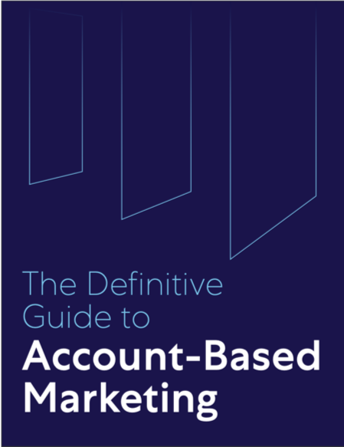
The Definitive Guide to Account-Based Marketing
Download now at marketo.com/definitive-guides/
the-definitive-guide-to-account-based-marketing

